Slide 1
Technical English for Computer Science
Week 10
Dr. Nur Banu OĞUR

Slide 2
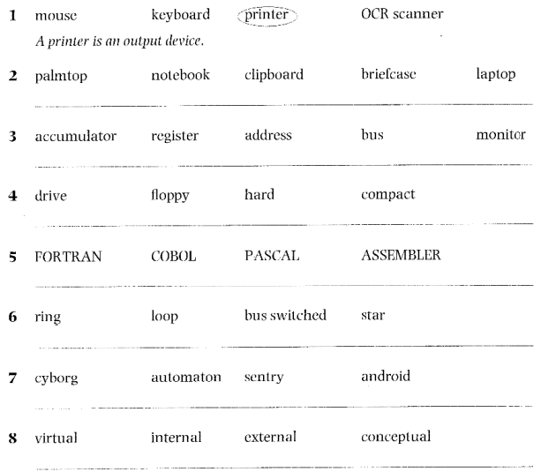
Look at the list and circle the Word that is different from others. Then explain why.

Slide 3
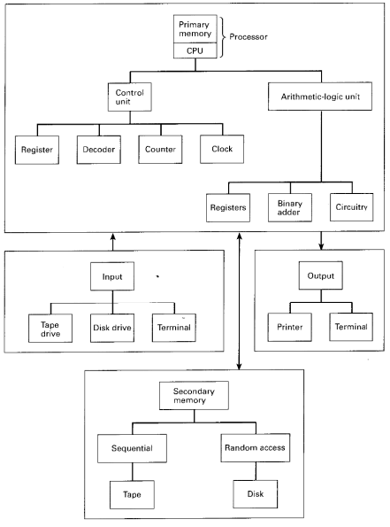
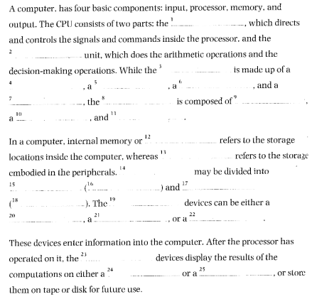

Slide 4
Reading...
Lost in Machine Translation...

Slide 5
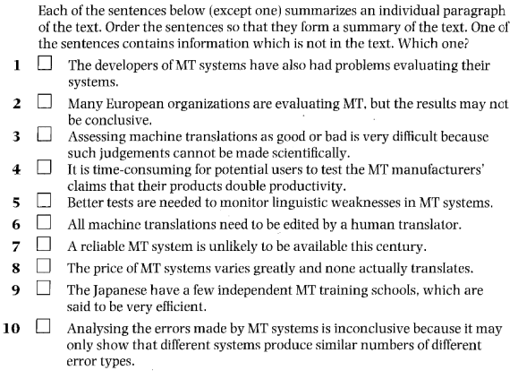

Slide 6


Slide 7
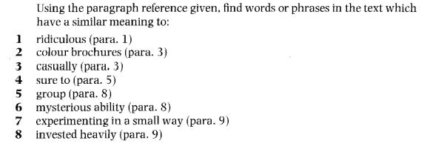

Slide 8
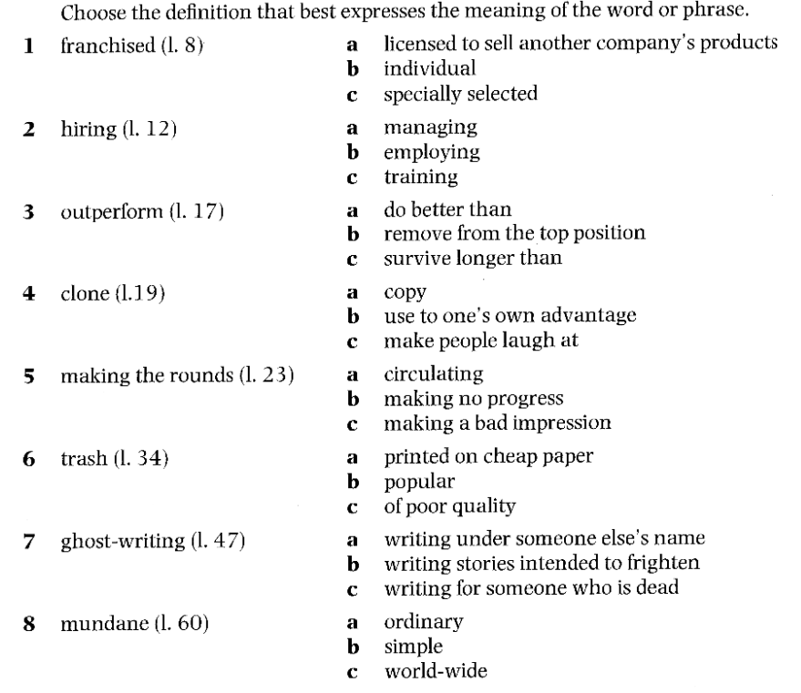

Slide 9
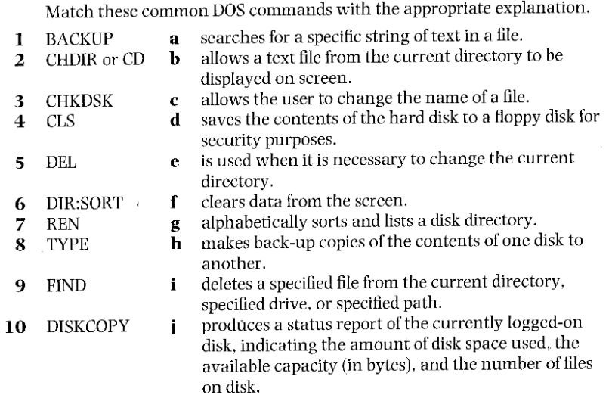

Slide 10
